Slide 1
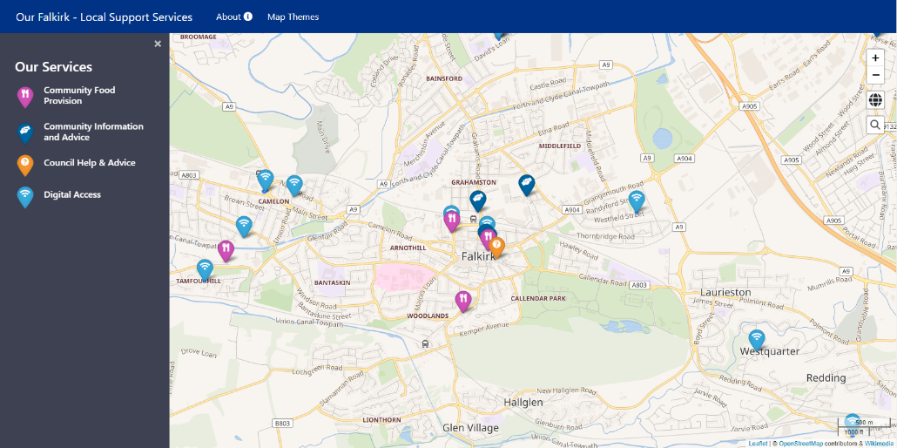
OUR Falkirk
Mitigating the impacts of poverty using OSM Data Themes
Alison Moon
Operations Manager
Notes:
Here today to talk about the Our Falkirk project
Developed in partnership with Falkirk Council and with funding from the ODI
Technically this was lead by one of our Senior Developers…but happy to take any technical questions away from today

Slide 2
Introductions…
Data Management
Strategy
Training
& Support
Consultancy
Analysis
GIS Solutions
Notes:
Some of these organisations may be more familiar to you than others so I’m going to start with some very brief introductions…
Start with thinkWhere as a long way from home and many may not know us…
Independent consultancy specialising in geospatial data, web mapping and GIS
Full lifecycle – strategy, product and solution development, consultancy, training and support… and we very much take a data centric approach….
Based in Codebase (a tech incubator) in Stirling
Customers – mix of public sector and commercial, close collaboration with Local Government: Falkirk Council – relationship for over many years
We are primarily an Open Source GIS company - Using leading edge Open Source Geographic Information System (GIS) technologies, we develop cloud-based software products and solutions
HoT Tasking Manager
Missing Maps events

Slide 3
ODI Data Stimulus fund
Aim - to gain insights into how local government organisations can best collect, publish and use open geospatial data
Notes:
Last year the ODI created a new stimulus fund to encourage better and innovative use of open geospatial data in the UK
Having worked closely both with various local authorities over many years and also having worked with OSM through our work with HOT and Missing Maps, we started to think through the current barriers to data sharing in local government and the potential for Open Street Map to be used to open up access to information to local communities

Slide 4
Towards a fairer falkirk
1 in 5 people live in poverty
1 in 4 children live in poverty
58% of people in poverty live in a household where someone is working
£62m less per year in Falkirk economy
Notes:
We approached Falkirk Council and started to discuss these ideas with their Fairer Falkirk team who are looking to tackle rising poverty in the area
To give a very brief bit of context:
The Falkirk council area is about on a par with the rest of Scotland with around 20% of its population in poverty
Where it differs from the average is the number of children in poverty – around 27% - due in part to its relatively high proportion of young families
Obviously this has an impact on them day to day, being cold, going hungry, and not being able to join in activities with friends; but also it has long term impacts on their aspirations, achievements and health.
They also told us that in-work poverty is a significant problem and that overall rates of poverty are set to rise due to the impact of the changes to the social security system that will take an estimated £62m per year from the Falkirk economy once fully rolled out.

Slide 5
Towards a fairer falkirk
Fairer Access to Services
Fairer Culture
Fairer Money
Fairer Childhood
“Poverty is both a cause and a consequence of poor access to services”
Towards a Fairer Falkirk 2019-2024
Notes:
They told us that the Fairer Falkirk strategy (which has just been refreshed for 2019-2024) recognises that neither the Council nor its partners are able to lift everyone out of poverty but that they can take steps to mitigate the impact that poverty has on individuals, children and families in the area.
To achieve this, the Fairer Falkirk strategy focuses on four key themes….
….underpinned by an action plan detailing the steps to be taken to deliver across each of these themes.
In terms of Fairer Access to Services that provide money advice, access to food provision such as food banks, digital access and community support are key to supporting those facing poverty. For example, digital access can help address the £490 per year “costs of being poor” through online shopping and getting better deals for utilities and mobile phones and so on…
However – there are challenges to opening up information about available services…
Challenges of collating and maintaining the data
Also, for the Council to manage and publish the data from a central data repository requires that there are data custodians within the Council with appropriate capabilities, skills and capacity/time
There also the cost of IT infrastructure/support and so on…

Slide 6
an open data approach…
Features
Mapping
OSM
Features
Notes:
So, with all this in mind, we defined the core idea of the project as using open data to support service discovery whilst minimising some of the overheads just mentioned.
Aim – “Our Falkirk” - a simple web mapping application that makes information about local services available online – both for the public but crucially also for frontline staff in the Council and other organisations so that they’re better able to signpost those in poverty to these services.
Data on the map – background mapping and the feature information displayed – would come from OSM, without any of that data needing to be stored, managed or maintained by the Council.
The features shown on the map are also coming directly from the OSM database rather than being held centrally by the Council. This is achieved by dynamically searching the OSM dataset and pulling back the features within that map extent that match particular attribute “tags” in the OSM data.
Use of OSM to host this data has significant advantages in that it saves the Council money on related IT overheads – just need somewhere to host the website, but also it means they don’t need specialist skills to create or maintain the data. Adding new features or adding appropriate tags to existing features in OSM is straight-forward and can be done using simple browser-based tools that require minimal training to use.
Council staff, partner bodies, the public even, can all then help to ensure that the data is up to date as and when new services become available (or are withdrawn) or as details of those services change.

Slide 7
Data Themes
Digital Access
Community Food Provision
Community Information & Advice
Council Help & Advice
Notes:
A key aspect of the system is that the application organises the information available in OSM into data themes for display to the user
These are logical groupings of OSM features that suit a particular purpose – this could be social, environmental, health and so on.
For this project, the Council and its partners worked closely together to define the key themes for the Our Falkirk application – they wanted to explore the types of services that would be helpful for local communities to know about and came up with these 4 initial themes, though have ideas for several more…
Also: for each theme, what information about those services would be helpful?
Digital Access:
Opening times
Membership info
Services available – printing, internet etc
Wheelchair accessible
The FF team then took on the work of collating all of that information so that we could then add it to the OSM dataset.
Challenges – some data themes being more comprehensively described than others – some of the groups providing services are small and often don’t have permanent premises or regular opening hours

Slide 8
THEME CREATION
Define the data needed
Are there geographic features
captured within OSM ?
Are there appropriate OSM tags
to describe these features?
New theme config
Our Falkirk web map
Define the tagging scheme
Add data & tags to OSM
Community
Feedback
OSM Database
Notes:
Firstly – defining the data needed:
Features already in OSM? Appropriately Tagged?
Needed to be a bit creative - e.g. “food bank” may be located within a church – may have distinct opening hours
some features existed already but other features were elements within a building so we created additional features points for these

Slide 9
Data Theme Tags
Notes:
In defining the tags to be used for a particular theme, we wanted to identify and use the tags most commonly in use
We made extensive use of TagInfo to research tags based on their popularity combined with looking at how similar features had been atrbiuted in OSM in our area / country.
The OSM community also provided lots of really valuable input and insight
However, as well as using existing tags, we also needed to extend these with new tags:
For the Digital Access theme we used a new namespace called “digital_access” - which is now documented in the project OSM wiki

Slide 10
Data theme tags
Notes:
Standards – needed to update “telephone” to “phone” because “telephone” isn’t a standard
OSM community really helpful in this

Slide 11
Data THEME CONFIG
Define the data needed
Are there geographic features
captured within OSM ?
Are there appropriate OSM tags
to describe these features?
New theme config
Our Falkirk web map
Define the tagging scheme
Add data & tags to OSM
Community
Feedback
OSM Database
Notes:
For each theme – the theme config defines:
what that theme’s about
the group of tags that comprise it
how it should be displayed by the application
Used by the application to dynamically pull back features from OSM and to configure the display of that information to the user

Slide 12
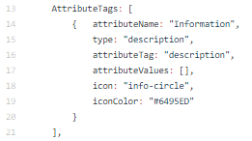
Data theme CONFIG
Notes:
Example – Food Provision theme
Config is essentially a lightweight schema that would describe the purpose and use of certain groups of tags representing a given theme.
These theme definitions could then be shareable – if someone’s already defined a theme that might suit your purpose you can take it and use it/amend it as needed
OverpassAPI query – specific format of queries - rate limited, slow.
Using a 3rd party library called QueryOverpass – give it a query and it will make an attempt (end point plus query) and once it gets data it will return it, if it doesn’t get the data it’ll wait a specified amount of time then try again – amount of time increases each time.

Slide 13
Data theme config
Notes:
So in terms of the output then…
Application written in a way as to be fairly generic to allow the configuration file to define how the data for that theme should be displayed
Use of these self-contained components is a flexible way of parsing data from OSM when you don’t know exactly what tags you’ll receive back
Pop-up – dynamic based on our themes and the data available for a feature. if tag is in our list and in the data then we will display it

Slide 14
Our Falkirk
Notes:
Demo - http://our.falkirk.gov.uk/

Slide 15
outcomes
Notes:
User/Local Gov perspective:
Our Falkirk enables non-expert users to map themes of interest
There is still some knowledge needed to define the relevant tags to use – still a manual process
Storing data on OSM so IT overheads kept to a minimum – all you need is somewhere to host the site
Data can be added through browser-based tools that require minimal training
OSM Perspective:
Interesting aspect lies in the use of data themes to define logical groups of features in OSM
Define a lightweight schema that would describe the purpose and use of certain tags – and could be shared with others and amended as needed
Showed how a project could use existing tags and extend these with new tags – aim being that these would become widely adopted
Process of suggesting new tags and themes for the OSM community not that well defined
OSM very flexible be can sometimes mean you don’t know where to start!

Slide 16
Future perspectives
Fairer Falkirk
Expand the audience
Enhanced data content
OSM / Wider Community
Theme Creation Wizard
Further Implementations / Functional Enhancements
Notes:
Additional themes:
Parent & toddler groups
Children’s activities
Furniture provision
Physical activity
Explore use of themes that capture temporary or seasonal services, e.g. summer and Christmas food projects and school holiday programmes
At the moment it’s likely they’d need further input to define the themes – both in terms of the researching the tags to use but also in terms of creating the config file
Promotion – internally and to the public
Used at BathHacked geospatial hack day by Leigh Dodds from the ODI

Slide 17
resources
Our Falkirk web map - http://our.falkirk.gov.uk
Open source code - https://github.com/thinkWhere/Open-Data-Viewer
Project OSM wiki – https://wiki.openstreetmap.org/wiki/User:Fairer_Falkirk
TagInfo – https://taginfo.openstreetmap.org/
Project Report - https://thinkwhere.com/wp-content/uploads/2019/02/ODI-final-report-Falkirk-Support-Services_Final.pdf

Slide 18
Thank you

