Slide 1
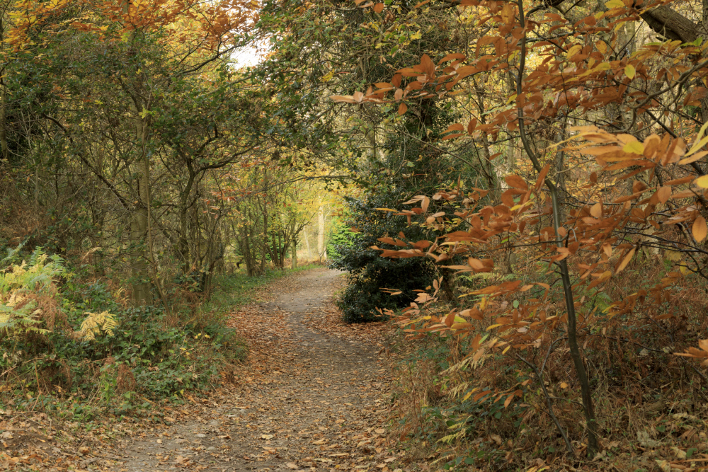
National Trust | Paths

Slide 2

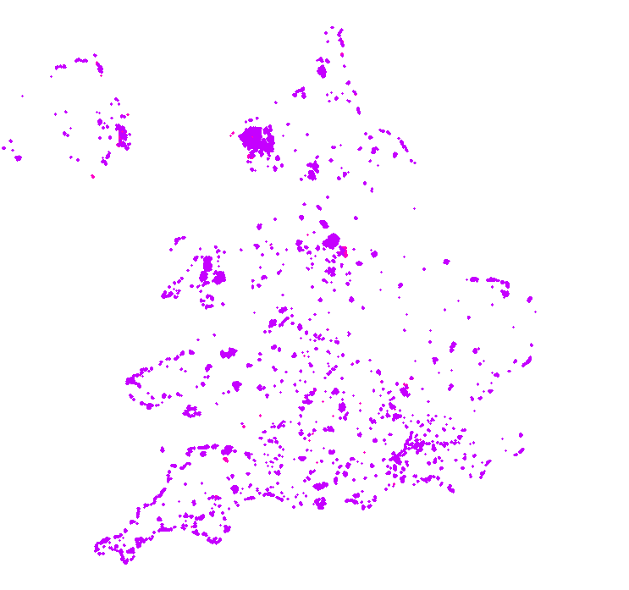
National Trust
Own / lease 250,000 ha – Largest land owner in the area we operate.
~5,000 Km PROW
~15,000 Km Permissive Paths
Don’t have a paths inventory
Access based organisation
Drive for more Open Data

Slide 3
Path Inventory
Digital Tool
(for properties & visitors)
NT
Trails
Curated map of all visitor trails on NT landscapes (walk, run, cycle etc.)
NT Primary Paths
Asset Management
Map of the main visitor paths at a property.
NT Path Inventory
Property Teams Rangers
Volunteers
Visitor Experience
GIS
Central asset register of all paths on NT managed land
External Community
Notes:
Path Inventory
No central map of path networks on NT manged land.
Paths provide access to places in our care – improving health, well-being and strengthening engagement with nature
No management oversight of scale, distribution and condition of path networks.
Unable to demonstrate or promote scale, report on path network condition or plan for investment
Path inventory forms basis of key NT intiatives – having an inventory feeds into identifying paths which are key for access to properties (primary paths). Paths are needed to curate trails.
Feeds into asset management (looking after what we’ve got) and future trail curation apps).
Proposal
Key: Path data
Estimates of ~20K KM of PRoW and permissive paths on NT managed land
Traditional survey methods impractical
Propose to utilise our property networks of rangers, volunteers, VE staff to verify routes on the ground and build the path inventory
By definition – have the best knowledge of where the routes are and who can access them (legally or permissive or pay for entry).
External volunteers or OSM
Build and inventory using local knowledge to verify routes

Slide 4
Open Paths
‘Open Paths’
Geospatial Commission Crowdsourcing Competition
Create, maintain and publish paths as Open Data.
Crowd source data to provide UK-wide path dataset.
Large land owners / Interest Groups / Downstream Market
NT Paths
Crowd
How to effectively Utilise a Crowd. UoS
Rule-Based App
Online / offline
1Spatial
Consistency
Establish standard tagging scheme for recording paths.
Open Data
Master data in OpenStreetMap.

Slide 5
Proposal
Capture all paths on National Trust owned / leased land into OpenStreetMap
Amend existing routes.
Digitise new routes.
Tag consistently
Access entitlement
Statutory, Permissive, Customer
Monitor
- Proactively monitor change

Slide 6
Schema
Physical |  | Access
highway |  |  |  | designation | foot | horse | bicycle | vehicle | motor_vehicle
footway/ bridleway/ cycleway/ track/ path/ service/ steps/ no |  | Public Right of Way | Footpath | public_footpath | designated | permissive/private /no | permissive/private /no | private/no | private/no
 |  |  | Bridleway | public_bridleway | designated | designated | yes | private/no | private/no
 |  |  | Restricted Byway | restricted_byway | designated | designated | designated | yes | private/no
 |  |  | Byway | byway_open_to_all_traffic | designated | designated | designated | yes | yes
 |  | Permissive Access | Permissive Footpath | permissive_footpath, - | permissive | private/no | private/no | private/no | private/no
 |  |  | Permissive Bridleway | permissive_bridleway, - | permissive | permissive | permissive | private/no | private/no
 |  |  | Permissive Cycle Path | permissive_cycleway, - | permissive/no | private/no | permissive | private/no | private/no
 |  | Pay for entry routes |  | - | customers/no | customers/no | customers/no | private/no | private/no
 |  | Access rights unknown |  | - | unknown/- | unknown/- | unknown/- | unknown/- | unknown/-
Optional descriptive tags:
prow_ref, surface, tracktype, name, wheelchair, bridge, ford etc.
Notes:
Project focus: Where the paths are and the legal/access rights
Optional descriptive tags for users benefit – Feed into future trail curation.

Slide 7
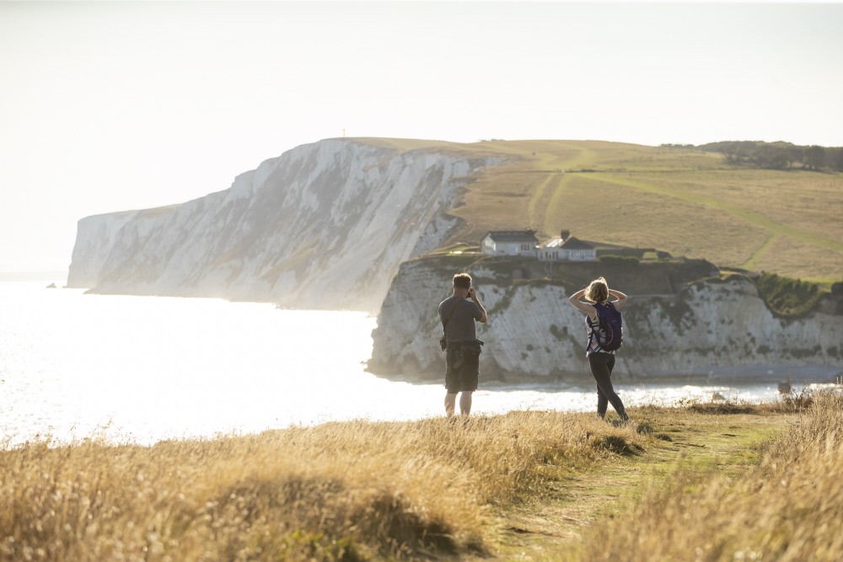
Case Studies

Slide 8
Notes:
Avebury – Definitive Line incorrect

Slide 9
Notes:
Osterley – Definitive line on NT land – route used on the ground not on NT land – No access on definitive – challenge as access organisation (tenant land)

Slide 10
Notes:
Lizard Airfield (Predannack) – Track exists on ROW but most common usage is not the definitive -> duty of care on definitive (access land)

Slide 11
Notes:
Marshfield no. 1 -

Slide 12
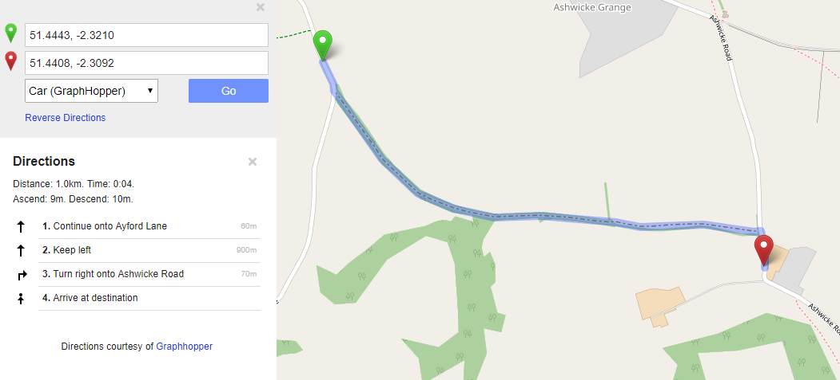
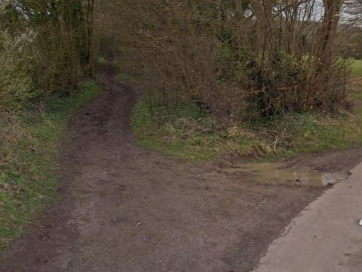
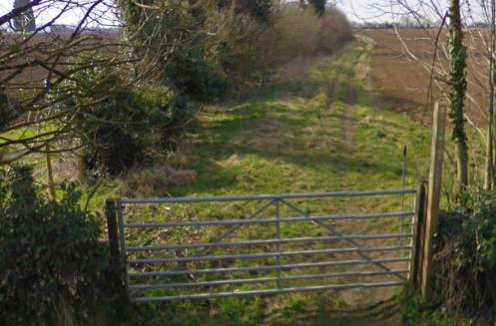
Notes:
Marshfield no.2 - routing

Slide 13
Project Timeline
Summer 2019
16 ‘Pioneer Properties’ – Variety.
  Trial methods, assess volume.
Property Team/Volunteer editor trial.
Autumn/Winter 2019
Lessons learnt.
  Refine processes, develop guidance.
Recruit editors.
Spring/Summer 2020
Launch wide-scale path data capture.
  Property Teams.
  Volunteers (NT, OSM).

Slide 14
Implications and Challenges
Crowd Editing
Splitting Objects
Licensing
Consistency & Monitoring
Notes:
Crowd Editing
In-field app – Editing app for rangers/volunteer teams to use
Splitting objects
OSM sticks to physical – split objects per access rights? (PRoW, permissive, pay for entry even if no visible change on the ground)
Licensing
Can others (e.g. OS, Google etc.) make use of the data? Unable to due to licencing terms.
Consistency & Monitoring
- Have schema and monitoring process – enforcing an agreed standard of paths on NT Land.

Slide 15
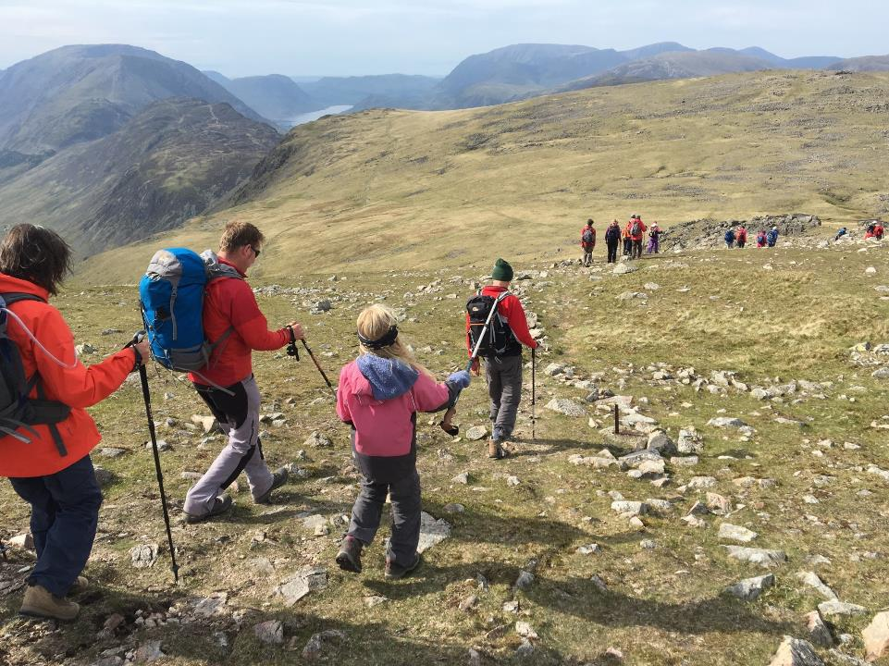
Q&A

